Slide 1

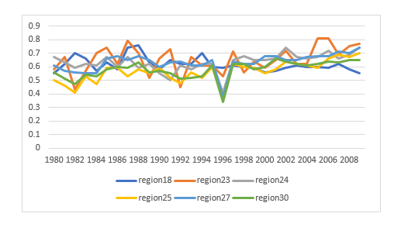

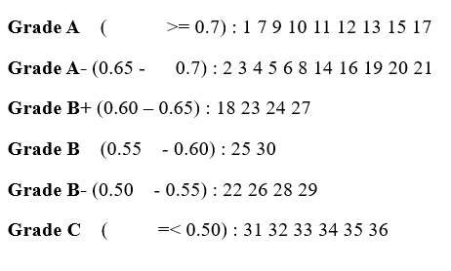
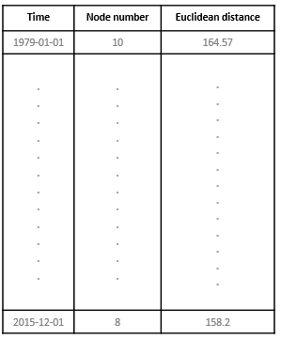
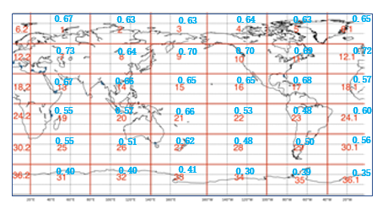
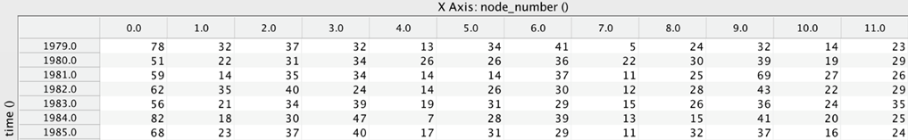
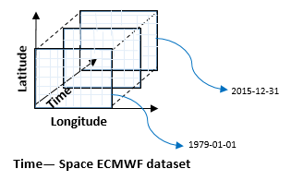
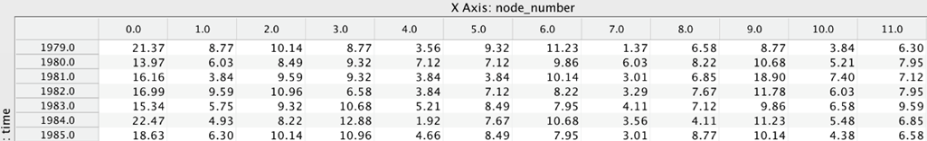
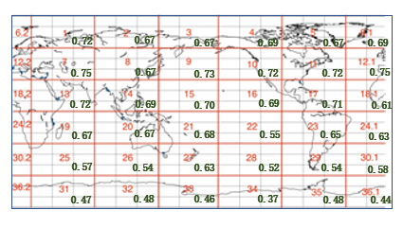
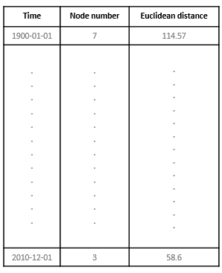
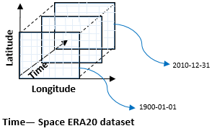
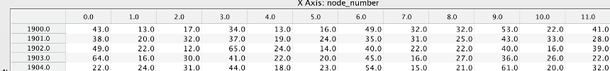
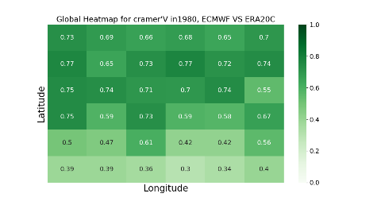
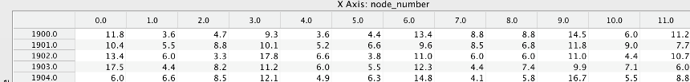
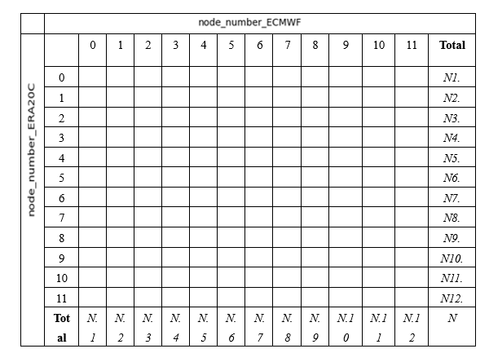
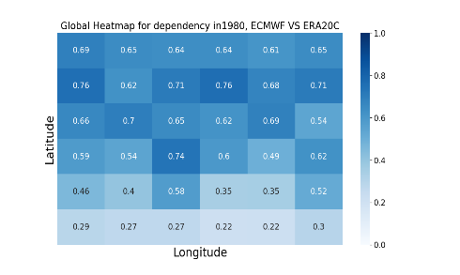
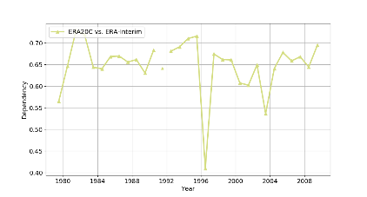
1
2
Latitude
3
PCA/EOF analysis
SOM analysis
4
5
6
Time
2010-12-31
Principal
components
Longitude
7
8
9
1900-01-01
10
11
12
Time— Space ERA20 dataset
SOM patterns nodes
BMU
Histogram of Frequency of occurrence,ECMWF
Average of dependency
Node dataset ECMWF
Histogram of Relative Frequency of occurrence,ECMWF
Average of Cramer’s V
Histogram of Frequency of occurrence,ERA20C
Node dataset ERA20C
Chi-square
Histogram of Relative Frequency of occurrence,ERA20C
Heatmap of Cramer’s V
entropy
Contingency Table
Time Series of dependency
Heatmap of dependency

